Slide 1
Chapter 13 Part 3

Slide 2
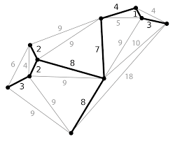
Chapter 13 Part 3: Graphs
Minimum Spanning Trees (MST)
Shortest Paths

Slide 3
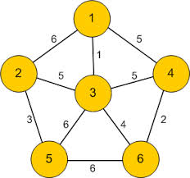
Representing Weighted Graphs
There are two types of weighted graphs
The vertices are assigned a weight
The edges are assigned a weight
Most common

Slide 4
Weighted Edge Graphs
In a weighted graph, each edge has an associated numerical value, called the weight of the edge
Edge weights may represent distances, costs, etc.
Example:
In a flight route graph, the weight of an edge represents the distance in miles between the endpoint airports
849
PVD
1843
ORD
142
SFO
802
LGA
1743
1205
337
1387
HNL
2555
1099
LAX
1233
DFW
1120
MIA

Slide 5
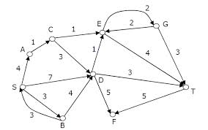
Representing Weighted Graphs
Edge Array
Weighted Adjacency Matrices
Priority Adjacency Lists

Slide 6
Representing Weighted Edges: Edge Array
int[ ][ ] edges = {{0, 1, 7}, {0, 3, 9},
{1, 0, 7}, {1, 2, 9}, {1, 3, 7},
{2, 1, 9}, {2, 3, 7}, {2, 4, 7},
{3, 0, 9}, {3, 1, 7}, {3, 2, 7}, {3, 4, 9},
{4, 2, 7}, {4, 3, 9}};
vertices
weight
{0, 1, 7}

Slide 7
Weighted Adjacency Matrices (1)
Assume that a graph has n vertices, one can use a n x n array to represent the weights
weights [i][j] represents the weight on edge (i,j)
If the vertices are not connected, then weights [i][j]= null
Weights do not have to be integers
Could be objects

Slide 8
Weighted Adjacency Matrices (2)
int adjacencyMatrix [ ][ ] =
{{null, 7, null, 9, null },
{7, null, 9, 7, null },
{null, 9, null, 7, 7},
{9, 7, 7, null, 9},
{null, null, 7, 9, null}};
adjacencyMatrix(0,0) =null
adjacencyMatrix(0,1) = 7
adjacencyMatrix(0,2) = null
adjacencyMatrix(0,3) = 9
adjacencyMatrix(0,4)=null
adjacencyMatrix(1,2)=9
adjacencyMatrix(2,4)=7

Slide 9
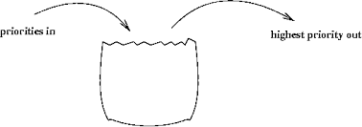
Priority Adjacency Lists (1)
Weight graphs using priority adjacency lists can implemented using priority queues
Edges are removed in increasing order

Slide 10
Priority Adjacency Lists (2)
Note: weights are removed in priority order (lowest first)

Slide 11
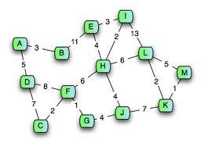
Shortest Path

Slide 12
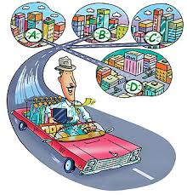
Traveling Salesperson Problem (1)
A tour of a graph is a spanning cycle (e.g., a cycle that goes through all the vertices)
A traveling salesperson tour of a weighted graph is a tour that is simple (i.e., no repeated vertices or edges) and has minimum weight

Slide 13
Traveling Salesperson Problem (2)
No polynomial-time algorithms are known for computing traveling salesperson tours
The traveling salesperson problem (TSP) is a major open problem in computer science
Finding a polynomial-time algorithm to compute a traveling salesperson tour or prove that none exists

Slide 14
Traveling Salesperson Problem (3)
7
D
B
4
2
2
5
F
C
8
6
3
E
A
1
Example of traveling salesperson tour
(with weight 17) – travels along the yellow weighted edges

Slide 15
Shortest Paths
Given a weighted graph and two vertices u and v, we want to find a path of minimum total weight between u and v
Length of a path is the sum of the weights of its edges
Applications
Internet packet routing
Flight reservations
Driving directions
849
PVD
1843
ORD
142
SFO
802
LGA
1743
1205
337
1387
HNL
2555
1099
LAX
1233
DFW
1120
MIA
Shortest path between Providence and Honolulu

Slide 16
Shortest Path Properties
Property 1:
A sub-path of a shortest path is itself a shortest path
Property 2:
There is a tree of shortest paths from a start vertex to all the other vertices
Example:
- Shortest path from Providence to HNL
849
PVD
1843
ORD
142
SFO
802
LGA
1743
1205
337
1387
HNL
2555
1099
LAX
1233
DFW
1120
MIA

Slide 17
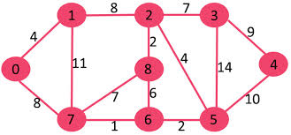
Dijkstra’s Algorithm Overview
The distance of a vertex v from a vertex s is the length of a shortest path between s and v
Dijkstra’s algorithm is used to find the shortest path
It computes the distances of all the vertices from a given start vertex s given the following assumptions:
The graph is connected
The edges are undirected
The edge weights are nonnegative

Slide 18

Dijkstra’s Algorithm Implementation
One grows a “cloud” of vertices, beginning with s and eventually covering all the vertices
One stores with each vertex v a label d(v) representing the distance of v from s in the sub-graph consisting of the “cloud” and its adjacent vertices
At each step
One adds to the “cloud” the vertex u outside the “cloud” with the smallest distance label, d(u)
One updates the labels of the vertices adjacent to u

Slide 19
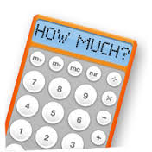
Dijkstra’s Algorithm Details (1)
The algorithm uses a costs[v] array to store the costs of the shortest path from vertex v to the source vertex s
costs[s]= 0
Distance from the starting vertex to itself
Initially one assigns infinity to costs[v] (where v does not equal s) to indicate that no path is found from v to s

Slide 20
Dijkstra’s Algorithm Details (2)
Let V denote all vertices and T denote the set of vertices whose costs have been found so far
Initially the source vertex s is in T
The algorithm repeatedly finds a vertex u in T and a vertex in V – T such that that costs[u] + w(u,v) is the smallest and moves v to T
w(u,v) denotes the weight of edge (u,v)

Slide 21
Single Source Shortest Path Algorithm (Dijkstra’s)
The algorithm starts by adding the source vertex s into T and sets costs[s] to 0
It continually adds vertices, v, to V – T into T
v is a vertex that is adjacent to a vertex in T with the smallest costs[u] + w(u,v)
If (u,v) has the smallest costs[u] + w(u,v), v will be added to T

Slide 22

Greedy Method
Solve the problem by repeatedly selecting the best choice from among those available

Slide 23
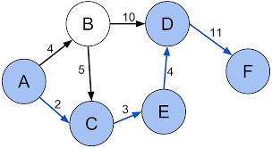
Dijkstra’s Single Source Shortest Path Algorithm
shortestPath(s) {
Let V denote the set of vertices in the graph;
Let T be a set that contains the vertices whose
path to s have been found;
Initially T contains source vertex s;
while (size of T < n) {
find v in V – T with the smallest costs[u] + w(u, v) value
among all u in T;
add v to T;
}
}

Slide 24
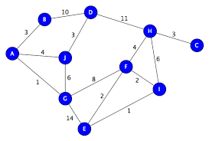
Dijkstra’s Algorithm Summary
Divides the vertices into two sets (T and V – T)
Repeatedly finds a vertex from V – T and adds it to T
T contains the vertices whose shortest path to the source have been found
The vertices are adjacent to some vertex in the set with the minimum total cost to the source
Dijkstra’s video
https://youtu.be/GazC3A4OQTE

Slide 25
Dijkstra’s Algorithm Example (1)
Suppose the source vertex is 1
costs[1] = 0
The costs for all other vertices are set to infinity
-
The algorithm will find the shortest paths from source vertex 1

Slide 26
Dijkstra’s Algorithm Example (2)
Initially T contains the source vertex
Vertices 2, 0, 6, and 3 are adjacent to the vertices in T
Vertex 2 has the smallest cost to source vertex 1
Vertex 2 is added to T and costs[2] = 6
-
Vertices {1, 2} are now in T

Slide 27
Dijkstra’s Algorithm Example (3)
Vertices 0, 6, and 3 are adjacent to the vertices in T
Vertex 6 has the smallest cost to source vertex 1
Vertex 6 is added to T and costs[6] = 7
Vertices {1, 2, 6} are now in T

Slide 28
Dijkstra’s Algorithm Example (4)
Vertices 0, 5, and 3 are adjacent to the vertices in T
Vertex 0 has the smallest cost to source vertex 1
Vertex 0 is added to T and costs[0] = 8
Vertices {1, 2, 6, 0} are now in T

Slide 29
Dijkstra’s Algorithm Example (5)
Vertices 5 and 3 are adjacent to the vertices in T
Vertex 3 has the smallest cost to source vertex 1
Vertex 3 is added to T and costs[3] = 10
Vertices {1, 2, 6, 0, 3} are in T

Slide 30
Dijkstra’s Algorithm Example (6)
Vertices 4 and 5 are adjacent to the vertices in T
Vertex 5 has the smallest cost to source vertex 1
Vertex 5 is added to T and costs[5] = 14
parent
Vertices {1, 2, 6, 0, 3, 5} are in T

Slide 31
Dijkstra’s Algorithm Example (7)
Vertices 4 is adjacent to the vertices in T
Vertex 4 has the smallest cost to source vertex 1
Vertex 4 is added to T and costs[4] = 18
parent
Vertices {1, 2, 6, 0, 3, 5, 4} are in T

Slide 32
Another Dijkstra Example (1)
0
0
8
A
4
8
A
4
2
2
8
7
2
1
4
8
7
2
1
3
B
C
D
B
C
D
∞
3
9
∞
3
9
2
5
5
8
E
F
2
E
F
5
0
0
8
A
4
8
A
4
2
2
8
7
2
1
3
7
7
2
1
3
B
C
D
B
C
D
5
3
9
11
5
3
9
8
2
E
F
5
2
E
F
5

Slide 33
Another Dijkstra Example (2)
0
8
A
4
2
7
7
2
1
3
B
C
D
5
3
9
8
2
E
F
5
0
8
A
4
2
7
7
2
1
3
B
C
D
5
3
9
8
2
E
F
5

Slide 34

Dijkstra’s Example starting at JFK
2704
867
BOS
849
PVD
ORD
187
740
144
1846
621
JFK
184
1258
802
SFO
BWI
1391
1464
337
1090
DFW
946
LAX
1235
1121
MIA
2342

Slide 35
Dijkstra’s Algorithm Example
See Next Page

Slide 36
All Shortest Paths from Chicago
All shortest paths from Chicago are:
A path from Chicago to Seattle: Chicago Seattle (cost: 2097)
A path from Chicago to San Francisco: Chicago Denver San Francisco (cost: 2270)
A path from Chicago to Los Angeles: Chicago Denver Los Angeles (cost: 2018)
A path from Chicago to Denver: Chicago Denver (cost: 1003)
A path from Chicago to Kansas City: Chicago Kansas City (cost: 533)
A path from Chicago to Chicago: Chicago (cost: 0)
A path from Chicago to Boston: Chicago Boston (cost: 983)
A path from Chicago to New York: Chicago New York (cost: 787)
A path from Chicago to Atlanta: Chicago Kansas City Atlanta (cost: 1397)
A path from Chicago to Miami: Chicago Kansas City Atlanta Miami (cost: 2058)
A path from Chicago to Dallas: Chicago Kansas City Dallas (cost: 1029)
A path from Chicago to Houston: Chicago Kansas City Dallas Houston (cost: 1268)
See Next Page

Slide 37
Edge Array for the Previous Map
int [ ][ ] edges = { {0, 1, 807}, {0, 3, 1331}, {0, 5, 2097},{1, 0, 807}, {1, 2, 381}, {1, 3, 1267}, {2, 1, 381}, {2, 3, 1015}, {2, 4, 1663}, {2, 10, 1435}, {3, 0, 1331}, {3, 2, 1015}, {3, 4, 599}, {3, 5, 1003}, {4, 2, 1663}, {4, 3, 599}, {4, 5, 533}, {4, 7, 1260},{4, 8, 864}, {4, 10, 496}, {5, 0, 2097}, {5, 3, 1003}, {5, 4, 533},{5, 6, 983}, {5, 7, 787}, {6, 5, 983}, {6, 7, 214},{7, 4, 1260}, {7, 5, 787}, {7, 6, 214}, {8, 4, 864}, {8, 7, 888}, {8, 9, 661}, {8, 10, 781}, {8, 11, 810}, {9, 8, 661}, {9, 11, 1187}, {10, 2, 1435}, {10, 4, 496}, {10, 8, 781}, {10, 11, 239},{11, 8, 810}, {11, 9, 1187}, {11, 10, 239} };
Where
String vertices [ ] = {"Seattle", "San Francisco", "Los Angeles", "Denver", "Kansas City", "Chicago", "Boston", "New York", "Atlanta", "Miami", "Dallas", "Houston"};

Slide 38
Dijkstra’s Algorithm Implementation
A priority queue stores the vertices outside the cloud
Key: distance
Element: vertex
Locator-based methods
insert(k,e) returns a locator
replaceKey(l,k) changes the key of an item
One stores two labels with each vertex:
Distance (d(v) label)
Locator in priority queue
Algorithm DijkstraDistances(G, s)
Q ← new heap-based priority queue
for all v ∈ G.vertices()
if v = s
setDistance(v, 0)
else
setDistance(v, ∞)
l ← Q.insert(getDistance(v), v)
setLocator(v,l)
while ¬Q.isEmpty()
u ← Q.removeMin()
for all e ∈ G.incidentEdges(u)
{ relax edge e }
z ← G.opposite(u,e)
r ← getDistance(u) + weight(e)
if r < getDistance(z)
setDistance(z,r) Q.replaceKey(getLocator(z),r)

Slide 39
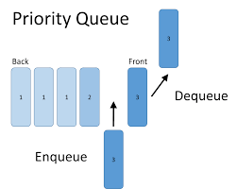
Analysis of Dijkstra’s Algorithm (1)
Graph operations
Method incidentEdges() is called once for each vertex
Label operations
One sets/gets the distance and locator labels of vertex z O(deg(z)) times
Setting/getting a label takes O(1) time
Priority queue operations
Each vertex is inserted once into and removed once from the priority queue, where each insertion or removal takes O(log n) time
The key of a vertex in the priority queue is modified at most deg(w) times, where each key change takes O(log n) time

Slide 40
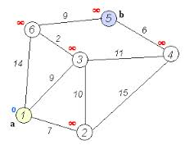
Analysis of Dijkstra’s Algorithm (2)
Dijkstra’s algorithm runs in O((n + m) log n) time provided the graph is represented by the adjacency list structure
Recall that Σ_{v} deg(v) = 2m

Slide 41
Why It Doesn’t Work for Negative-Weight Edges
Dijkstra’s algorithm is based on the greedy method
It adds vertices by increasing distance
0
If a node with a negative incident edge were to be added late to the cloud, it could mess up distances for vertices already in the cloud
A
4
8
6
7
7
5
1
4
B
C
D
5
0
-8
9
2
E
F
5
C’s true distance is 1 (4+5-8), but it is already in the cloud with d(C)=5

Slide 42

Time Complexity
The overall time complexity for Dijkstra’s algorithm is O(|E|log|v|) , where |E| denotes the number of edges and |V| denotes the number of vertices

Slide 43
Minimum Spanning Trees
2704
867
BOS
849
PVD
ORD
740
187
1846
JFK
144
621
802
184
1258
SFO
1391
BWI
337
1464
1090
LAX
1235
DFW
946
1121
MIA
2342

Slide 44
Trees and Forests
A (free) tree is an undirected graph T such that
T is connected
T has no cycles
A forest is an undirected graph without cycles
The connected components of a forest are trees
Tree
Forest

Slide 45
Minimum Spanning Trees
Spanning sub-graph
Subgraph of a graph G containing all the vertices of G
Spanning tree
Spanning sub-graph that is itself a (free) tree
Minimum spanning tree (MST)
Spanning tree of a weighted graph with minimum total edge weight
Applications
Communications networks
Transportation networks
ORD
10
1
PIT
DEN
6
7
9
3
DCA
4
STL
8
5
2
DFW
ATL
MST are not necessary unique if the weights are not distinct

Slide 46
Cycle Property
Cycle Property:
Let T be a minimum spanning tree of a weighted graph G
Let e be an edge of G that is not in T and C let be the cycle formed by e with T
For every edge f of C, weight(f) ≤ weight(e)
Proof:
By contradiction
If weight(f) > weight(e) we can get a spanning tree of smaller weight by replacing e with f
f
8
4
C
9
2
6
3
e
8
7
7
Replacing f with e yields a better spanning tree
f
8
4
C
9
2
6
3
e
8
7
7

Slide 47
Partition Property
Partition Property:
Consider a partition of the vertices of G into subsets U and V
Let e be an edge of minimum weight across the partition
There is a minimum spanning tree of G containing edge e
Proof:
Let T be an MST of G
If T does not contain e, consider the cycle C formed by e with T and let f be an edge of C across the partition
By the cycle property, weight(f) ≤ weight(e)
Thus, weight(f) = weight(e)
We obtain another MST by replacing f with e
U
V
f
7
4
9
2
5
8
8
e
3
7
Replacing f with e yields another MST
U
V
f
7
4
9
2
5
8
8
e
3
7

Slide 48

Minimum Spanning Trees Example (1)
A cable TV company needs to lay cable to a new neighborhood
If it is constrained to bury the cable only along certain paths, then there would be a graph representing which points are connected by those paths
Some of those paths might be more expensive, because they are longer, or require the cable to be buried deeper; these paths would be represented by edges with larger weights

Slide 49
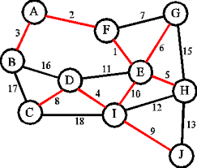
Minimum Spanning Trees Example (2)
A spanning tree for that graph would be a subset of those paths that has no cycles but still connects to every house
There might be several spanning trees possible
A minimum spanning tree would be one with the lowest total cost

Slide 50
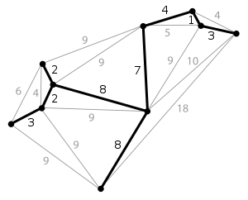
Minimum Spanning Tree Example

Slide 51
Minimum Spanning Trees
A
B (42)
C (38)
D (38)
The trees in Figures B, C, D are spanning trees for the graph in Figure A
The trees in Figures C and D are minimum spanning trees

Slide 52

Prim-Jarnik’s Algorithm Overview (1)
Similar to Dijkstra’s algorithm (for a connected graph)
One picks an arbitrary vertex s and one grows the MST as a cloud of vertices, starting from s
One stores with each vertex v a label d(v) = the smallest weight of an edge connecting v to a vertex in the cloud

Slide 53

Prim-Jarnik’s Algorithm Overview (2)
At each step:
One adds to the cloud the vertex u outside the cloud with the smallest distance label
One updates the labels of the vertices adjacent to u

Slide 54

Prim-Jarnik’s Algorithm Overview (3)
A priority queue stores the vertices outside the cloud
Key: distance
Element: vertex
Locator-based methods
insert(k,e) returns a locator
replaceKey(l,k) changes the key of an item
One stores three labels with each vertex
Distance
Parent edge in MST
Locator in priority queue

Slide 55
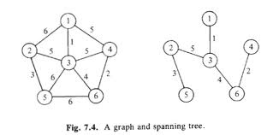
Prim-Jarnik’s Minimum Spanning Tree Algorithm
minimumSpanningTree() {
Let V denote the set of vertices in the graph;
Let T be a set for the vertices in the spanning tree;
Initially, add the starting vertex to T;
while (size of T < n) {
find u in T and v in V – T with the smallest weight on the edge (u, v), (see on the next page)
add v to T;
}
}

Slide 56
Prim-Jarnik’s Minimum Spanning Tree Algorithm
The algorithm starts by adding the starting vertex into T
The algorithm continuously adds an adjacent vertex (v) from V - T with the smallest weight on the edge

Slide 57
Prim-Jarnik’s Algorithm
Algorithm PrimJarnikMST(G)
Q ← new heap-based priority queue
s ← a vertex of G
for all v ∈ G.vertices()
if v = s
setDistance(v, 0)
else
setDistance(v, ∞)
setParent(v, ∅)
l ← Q.insert(getDistance(v), v)
setLocator(v,l)
while ¬Q.isEmpty()
u ← Q.removeMin()
for all e ∈ G.incidentEdges(u)
z ← G.opposite(u,e)
r ← weight(e)
if r < getDistance(z)
setDistance(z,r)
setParent(z,e) Q.replaceKey(getLocator(z),r)

Slide 58
Prim-Jarnik’s Minimum Spanning Tree Algorithm
1
2
0
6
3
5
4
See Next Page

Slide 59
Adding Vertices using Prim’s Algorithm
Add vertex 0 to T
Add vertex 5 to T since edge (5,0,5) has the smallest weight (5) among the edges adjacent to T
Add vertex 1 to T since edge (1,0,6) has the smallest weight (6) among the edges adjacent to T
Add vertex 6 to T since edge (6,1,7) has the smallest weight (7) among the edges adjacent to T
Add vertex 2 to T since edge (2,6, 5) has the smallest weight (5) among the edges adjacent to T
Add vertex 4 to T since edge (4,6,7) has the smallest weight (7) among the edges adjacent to T
Add vertex 3 to T since edge (3,2,8) has the smallest weight (7) among the edges adjacent to T
The adjacent vertices with the smallest weight are added sequentially

Slide 60

Using Prim-Jarnik’s Algorithm
Minimum Spanning Tree

Slide 61
Prim-Jarnik’s Example (1)
∞
7
2
7
D
2
7
D
B
4
B
4
8
9
∞
5
9
∞
2
5
F
2
5
F
C
8
C
8
8
3
8
3
E
E
A
7
7
A
7
7
0
0
7
7
2
7
D
7
D
B
4
2
B
4
5
9
∞
9
4
2
5
F
5
5
C
2
F
8
C
8
8
3
3
E
8
A
7
E
0
7
A
7
7
0

Slide 62
Prim-Jarnik’s Example (2)
7
2
7
D
B
4
5
9
4
2
5
F
C
8
8
3
E
A
7
3
7
0
7
D
2
B
4
5
9
4
2
5
F
C
8
8
3
E
A
7
3
0

Slide 63
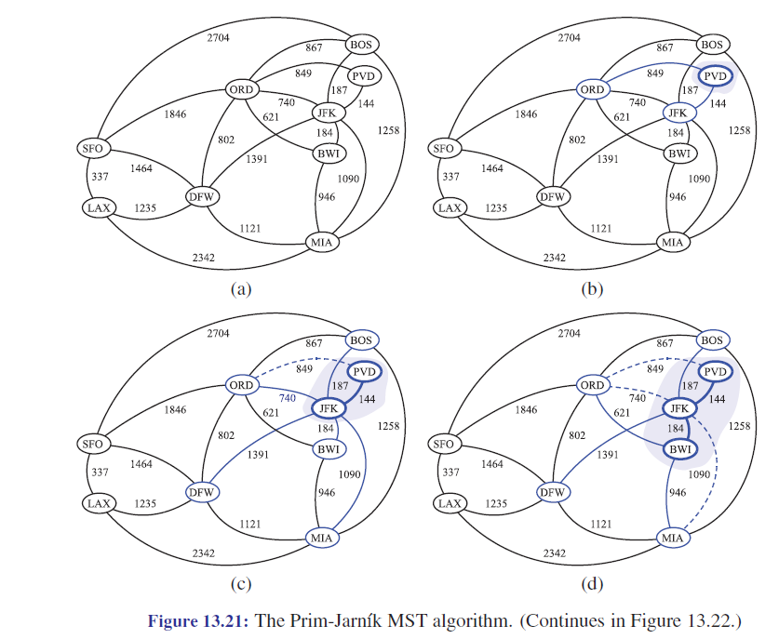
Prim-Jarnik’s Algorithm (1)
See example 13.21

Slide 64
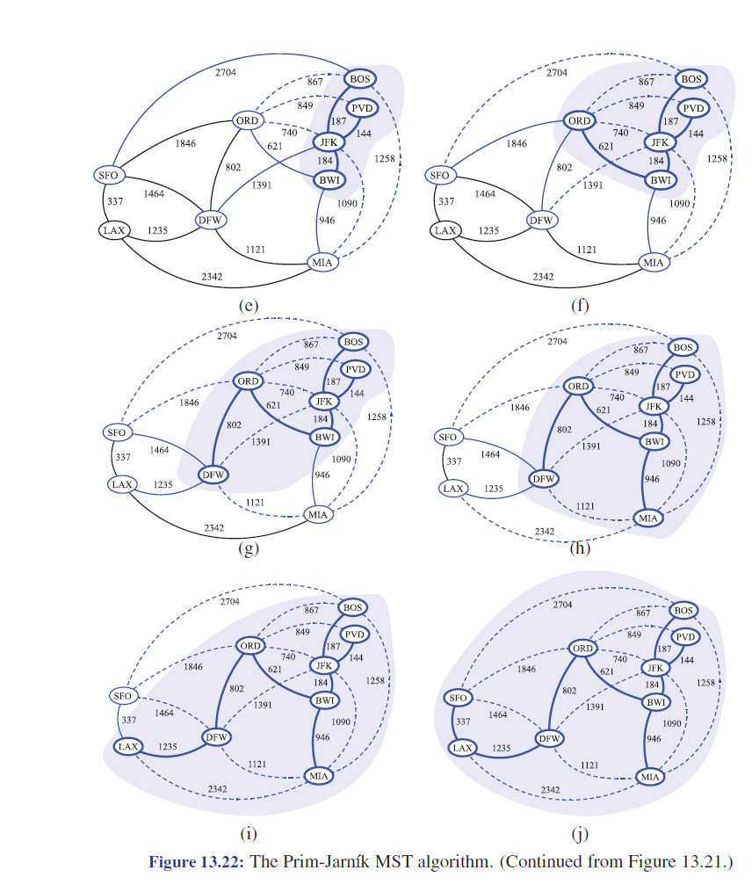
Prim-Jarnik’s Algorithm (2)

Slide 65

Prim-Jarnik’s Analysis
Graph operations
Method incidentEdges() is called once for each vertex
Label operations
One sets/gets the distance, parent and locator labels of vertex z O(deg(z)) times
Setting/getting a label takes O(1) time

Slide 66

Prim-Jarnik’s Analysis
Priority queue operations
Each vertex is inserted once into and removed once from the priority queue, where each insertion or removal takes O(log n) time
The key of a vertex w in the priority queue is modified at most deg(w) times, where each key change takes O(log n) time
Prim-Jarnik’s algorithm runs in O((n + m) log n) time provided the graph is represented by the adjacency list structure
Recall that S_{v} deg(v) = 2m
The running time is O(m log n) since the graph is connected

Slide 67
Minimum Spanning Tree (MST) Example
Total weight is 6513
Root is: Seattle
Edges: (Seattle, San Francisco) (San Francisco, Los Angeles) (Los Angeles, Denver) (Denver, Kansas City) (Kansas City, Chicago) (New York, Boston) (Chicago, New York) (Dallas, Atlanta) (Atlanta, Miami) (Kansas City, Dallas) (Dallas, Houston)
See Next Page

Slide 68
Edge Array for the Previous Map
int [ ][ ] edges = { {0, 1, 807}, {0, 3, 1331}, {0, 5, 2097},{1, 0, 807}, {1, 2, 381}, {1, 3, 1267}, {2, 1, 381}, {2, 3, 1015}, {2, 4, 1663}, {2, 10, 1435}, {3, 0, 1331}, {3, 2, 1015}, {3, 4, 599}, {3, 5, 1003}, {4, 2, 1663}, {4, 3, 599}, {4, 5, 533}, {4, 7, 1260},{4, 8, 864}, {4, 10, 496}, {5, 0, 2097}, {5, 3, 1003}, {5, 4, 533},{5, 6, 983}, {5, 7, 787}, {6, 5, 983}, {6, 7, 214},{7, 4, 1260}, {7, 5, 787}, {7, 6, 214}, {8, 4, 864}, {8, 7, 888}, {8, 9, 661}, {8, 10, 781}, {8, 11, 810}, {9, 8, 661}, {9, 11, 1187}, {10, 2, 1435}, {10, 4, 496}, {10, 8, 781}, {10, 11, 239},{11, 8, 810}, {11, 9, 1187}, {11, 10, 239} };
Where
String vertices [ ] = {"Seattle", "San Francisco", "Los Angeles", "Denver", "Kansas City", "Chicago", "Boston", "New York", "Atlanta", "Miami", "Dallas", "Houston"};

Slide 69
Kruskal’s Algorithm
Maintain a partition of the vertices into clusters
Initially, single-vertex clusters
Keeps an MST for each cluster
Merges “closest” clusters and their MSTs
A priority queue stores the edges outside clusters
Key: weight
Element: edge
At the end of the algorithm
One cluster and one MST
Algorithm KruskalMST(G)
for each vertex v in G do
Create a cluster consisting of v
let Q be a priority queue.
Insert all edges into Q
T ← ∅
{T is the union of the MSTs of the clusters}
while T has fewer than n (1) edges do e ← Q.removeMin().getValue()
[u, v] ← G.endVertices(e)
A ← getCluster(u)
B ← getCluster(v)
if A ≠ B then
Add edge e to T
mergeClusters(A, B)
return T

Slide 70
Kruskal Example
2704
867
BOS
849
PVD
ORD
187
740
144
1846
621
JFK
184
1258
802
SFO
BWI
1391
1464
337
1090
DFW
946
LAX
1235
1121
MIA
2342

Slide 71
Kruskal #1

Slide 72
Kruskal #2

Slide 73
Example
Kruskal #3

Slide 74
Kruskal #4

Slide 75
Kruskal #5

Slide 76
Kruskal #6

Slide 77
Kruskal #7

Slide 78
Kruskal #8

Slide 79
Kruskal #9

Slide 80
Kruskal #10

Slide 81
Kruskal #11

Slide 82
Kruskal #12

Slide 83
MST
2704
867
BOS
849
PVD
ORD
187
740
144
1846
621
JFK
184
1258
802
SFO
BWI
1391
1464
337
1090
DFW
946
LAX
1235
1121
MIA
2342

Slide 84
Campus Tour

Slide 85
Kruskal’s Algorithm Example (1)
G
G
B
8
8
4
B
4
9
E
6
9
E
6
1
5
F
1
5
F
C
11
3
C
11
3
2
2
7
D
H
7
H
A
D
10
A
10
G
G
B
8
B
8
4
4
9
E
6
9
E
6
1
5
F
1
5
F
C
11
3
C
11
3
2
2
7
D
H
7
H
D
A
10
A
10

Slide 86
Kruskal’s Algorithm Example (2)
G
G
B
8
8
4
B
4
9
E
6
9
E
6
1
5
F
1
5
F
C
11
3
C
11
3
2
2
7
D
H
7
H
D
A
10
A
10
four steps
two steps
G
G
B
8
B
8
4
4
9
E
6
9
E
6
1
5
F
1
5
F
C
11
3
C
11
3
2
2
7
D
H
7
D
H
A
10
A
10

Slide 87
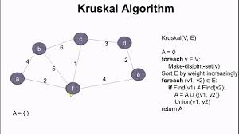
Data Structure for Kruskal’s Algorithm
The algorithm maintains a forest of trees
A priority queue extracts the edges by increasing weight
An edge is accepted it if connects distinct trees
One needs a data structure that maintains a partition, i.e., a collection of disjoint sets, with operations:
makeSet(u): create a set consisting of u
find(u): return the set storing u
union(A, B): replace sets A and B with their union

Slide 88
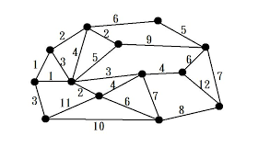
Analysis of Kruskal’s Algorithm (1)
Graph operations
Methods vertices and edges are called once
Method endVertices is called m times
Priority queue operations
One performs m insert operations and m removeMin operations
Partition operations
One performs n makeSet operations, 2m find operations and no more than n (1) union operations

Slide 89

Analysis of Kruskal’s Algorithm (2)
Label operations
One sets vertex labels n times and get them 2m times
Kruskal’s algorithm runs in time O((n + m) log n) time provided the graph has no parallel edges and is represented by the adjacency list structure

Slide 90

Prim’s vs. Krusal
Prim's algorithm is significantly faster in the limit when you've got a really dense graph with many more edges than vertices
Kruskal 's algorithm performs better in typical situations (sparse graphs) because it uses simpler data structures

Slide 91

A* Algorithm (Improved Dijkstra’s Algorithm)
http://www.policyalmanac.org/games/aStarTutorial.htm

Slide 92
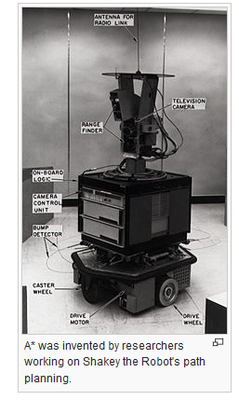
History
In 1968, artificial intelligence (AI) researcher Nils Nilsson was trying to improve the path planning done by Shakey the Robot
A prototype robot that could navigate through a room containing obstacles

Slide 93

History
This path-finding algorithm, called A1, was a faster version of the then best known method, Dijkstra's algorithm for finding shortest paths in graphs
Bertram Raphael suggested some significant improvements upon this algorithm, calling the revised version A2
Peter E. Hart introduced an argument that established A2, with only minor changes, to be the best possible algorithm for finding shortest paths

Slide 94

A* Algorithm Overview
Is widely used in pathfinding (shortest route between two points) and graph traversals due to its performance and accuracy

Slide 95

A* Algorithm (1)
A* is an a best-first search
Solves problems by searching among all possible paths to a solution (goal) for the one that incurs the smallest cost (least distance travelled, shortest time, etc.)
It first considers the paths that appear to lead most quickly to the solution

Slide 96
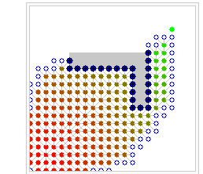
A* Algorithm (2)
Starting from a specific node of a graph, it constructs a tree of paths starting from that node, expanding paths one step at a time, until one of its paths ends at the predetermined goal node
Typical implementations of A* use a priority queue to perform the repeated selection of minimum (estimated) cost nodes to expand

Slide 97
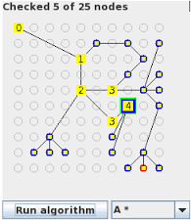
The A* Search Algorithm
Let’s assume that one has someone who wants to get from point A to point B
Let’s assume that a wall separates the two points
This is illustrated with green being the starting point A, and red being the ending point B, and the blue filled squares being the wall in between (see next slide)

Slide 98
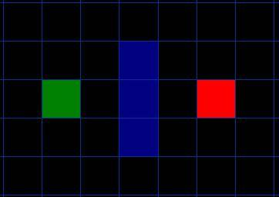
The Search Area Illustrated

Slide 99

Getting Started (1)
The search area is divided into a square grid
Each item in the array represents one of the squares on the grid, and its status is recorded as walkable or un-walkable
The path is found by figuring out which squares one should take to get from A to B

Slide 100

Getting Started (2)
Once the path is found, a person moves from the center of one square to the center of the next until the target is reached
These center points are called “nodes”

Slide 101

Starting the Search (1)
One begins at the starting point A
One creates an “open list” of squares to be considered and adds A to the open list
The open list is kind of like a shopping list

Slide 102
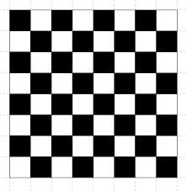
Starting the Search (2)
Initially there is just one item on the list (A), but more will be added later
It contains squares that might fall along the path that one may or may not want to take
Basically, it is a list of squares that need to be checked out

Slide 103

Starting the Search (3)
One looks at all the reachable or walkable squares adjacent to the starting point, ignoring squares with walls, water, or other illegal terrain
Adds them to the open list
For each of these squares, save point A as its “parent square”
This parent square concept is important when one wants to trace the path

Slide 104

Starting the Search (4)
Drop the starting square A from the open list, and add it to a “closed list” of squares
Squares that one doesn’t need to consider again for now

Slide 105
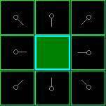
The Search Area (1)
The dark green square in the center is the starting square
It is outlined in light blue to indicate that the square has been added to the closed list
All of the adjacent squares are now on the open list of squares to be checked, and they are outlined in light green
Each has a gray pointer that points back to its parent, which is the starting square

Slide 106
The Search Area (2)

Slide 107
Path Scoring
The key to determining which squares to use when figuring out the path is governed by following equation:
F = G + H
G = the movement cost to move from the starting point A to a given square on the grid, following the path generated to get there
H = the estimated movement cost to move from that given square on the grid to the final destination, point B
This is often referred to as the heuristic (guess)
One really don’t know the actual distance until one finds the path, because of obstacles (walls, water, etc.)

Slide 108
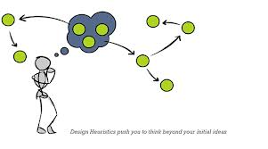
Heuristics (1)
Refers to experience-based techniques for problem solving, learning, and discovery that gives a solution which is not guaranteed to be optimal

Slide 109
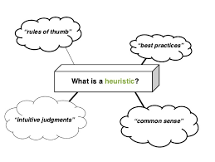
Heuristics (2)
Heuristic methods are used to speed up the process of finding a satisfactory solution via mental shortcuts to ease the cognitive load of making a decision
Rule of thumb, educated guess, intuitive judgment, common sense
It could be considered a shortcut

Slide 110

Heuristic Function
A Heuristic function ranks alternatives in search algorithms at each branching step based on available information to decide which branch to follow

Slide 111

Choosing a Path
A path is generated by repeatedly going through the open list and choosing the square with the lowest F score

Slide 112
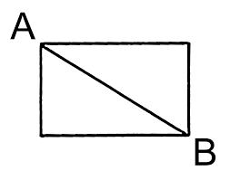
Assigning a Cost to G
Assign a cost of 10 to each horizontal or vertical square moved, and a cost of 14 for a diagonal move
Use these numbers because the actual distance to move diagonally is the square root of 2 (1.414) times the cost of moving horizontally or vertically
The way to figure out the G cost of that square is to take the G cost of its parent, and then add 10 or 14 depending on whether it is diagonal or orthogonal (non-diagonal) from that parent square
(F = G+H)

Slide 113
Assigning a Cost to H
The method used in this example is called the Manhattan method
One calculates the total number of squares moved horizontally and vertically to reach the target square from the current square, ignoring diagonal movement, and ignoring any obstacles
One then multiplies the total by 10
The cost for moving one square horizontally or vertically
(F = G+H)
This is called the Manhattan Method because it is like calculating the number of city blocks from one place to another, where one can’t cut across the block diagonally

Slide 114
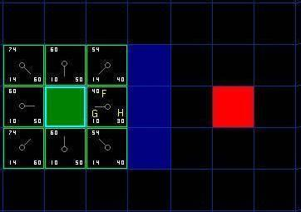
The Search Area Labelled
F is in the top left, G is in the bottom left, and H is in the bottom right

Slide 115

Continuing the Search (1)
To continue the search, one simply chooses the lowest F score square from all those that are on the open list

Slide 116

Continuing the Search (2)
Then do the following with the selected square
Drop it from the open list and add it to the closed list
Check all of the adjacent squares (ignoring those that are on the closed list or un-walkable)
Add squares to the open list if they are not on the open list already
Make the selected square the “parent” of the new squares

Slide 117

Continuing the Search (3)
If an adjacent square is already on the open list, check to see if this path to that square is better

Slide 118

Continuing the Search (4)
In other words, check to see if the G score for that square is lower if one uses the current square to get there
If not, continue
On the other hand, if the G cost of the new path is lower, change the parent of the adjacent square to the selected square (change the direction of the pointer to point to the selected square)
Finally, recalculate both the F and G scores of that square
(F = G+H)

Slide 119

Implementing the Search (1)
Of the initial nine squares, there are eight left on the open list after the starting square was switched to the closed list
Of these, the one with the lowest F cost is the one to the immediate right of the starting square, with an F score of 40
One selects this square as the next square
It is highlighted in blue on the next slide

Slide 120
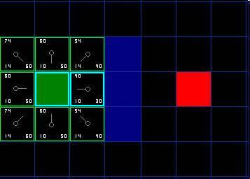
Implementing the Search (2)

Slide 121
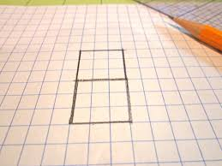
Implementing the Search (3)
One drops the square from the open list and adds it to the closed list (that’s why it’s now highlighted in blue)
Then one checks the adjacent squares
The ones to the immediate right of this square are wall squares, so they are ignored
The one to the immediate left is the starting square
Its on the closed list, so it is ignored

Slide 122
Implementing the Search (4)
The other four squares are already on the open list, so one needs to check if the paths to those squares are any better using this square to get there, using G scores as the point of reference

Slide 123
Implementing the Search (5)
The square right above the selected square has a G score of 14
If one went through the current square to get there, the G score would be equal to 20 (10, which is the G score to get to the current square, plus 10 more to go vertically to the one just above it)

Slide 124
Implementing the Search (6)
A G score of 20 is higher than 14, so this is not a better path (That should make sense if one looks at the diagram)
It’s more direct to get to that square from the starting square by simply moving one square diagonally to get there, rather than moving horizontally one square, and then vertically one square

Slide 125
Implementing the Search (7)
When one repeats this process for all four of the adjacent squares already on the open list, one finds that none of the paths are improved by going through the current square, so one doesn’t change anything

Slide 126

Implementing the Search (8)
Since one has looked at all of the adjacent squares
The process with this square is complete
One should now move to the next square

Slide 127
Implementing the Search (9)
One goes through the list of squares on the open list, which is now down to seven squares, and picks the one with the lowest F cost

Slide 128
Implementing the Search (10)
In this case, there are two squares with a score of 54 (it doesn’t matter which one is chosen)
In this case, choose the one just below, and to the right of the starting square, as is shown on the next slide

Slide 129
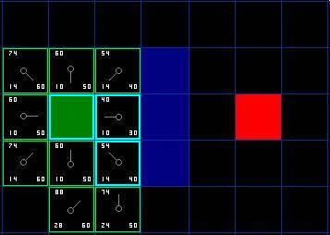
Implementing the Search (11)

Slide 130
Implementing the Search (12)
When one checks the adjacent squares one finds that the one to the immediate right is a wall square, so one ignores this square
The square just above is already on the closed list

Slide 131
Implementing the Search (13)
One also ignores the square just below the wall
One can’t get to that square directly from the current square without cutting (white arrow) across the corner of the nearby wall
One needs to go down first and then move over to that square, moving around the corner in the process
invalid

Slide 132
Implementing the Search (14)
Five other squares need be to be investigated
The two squares below the current square aren’t already on the open list, so one adds them and the current square becomes their parent

Slide 133
Implementing the Search (15)
Of the other three squares, two are already on the closed list (the starting square, and the one just above the current square, both highlighted in blue in the diagram), so one ignores them

Slide 134
Implementing the Search (16)
The last square, to the immediate left of the current square, is checked to see if the G score is any lower if one goes through the current square to get there
This is not the case so one is done and ready to check the next square on the open list

Slide 135
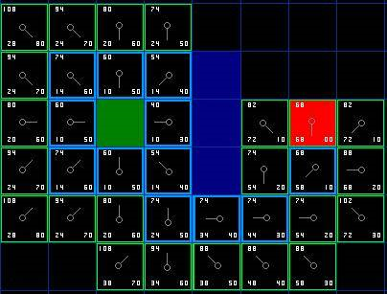
The Search Area (17)
Repeating the process

Slide 136

Determining the Path (1)
Start at the red target square, and work backwards moving from one square to its parent, following the arrows
This will eventually takes one back to the starting square, and that’s the path

Slide 137
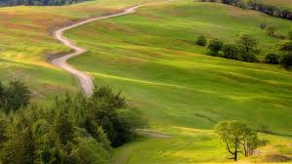
Determining the Path (2)
Moving from the starting square A to the destination square B is simply a matter of moving from the center of each square (the node) to the center of the next square on the path, until one reaches the target

Slide 138
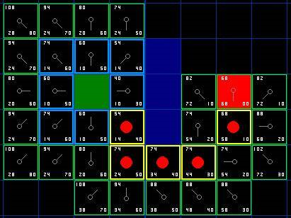
Determining the Path (3)
Identifying the path

Slide 139

Summary (1)
Add the starting square (or node) to the open list
Repeat the following:
Look for the lowest F cost square on the open list
One refers to this as the current square
Switch it to the closed list

Slide 140
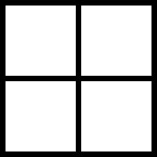
Summary (2)
For each of the eight squares adjacent to this current square …
If it is not walk-able or if it is on the closed list, ignore it

Slide 141

Summary (3)
Otherwise do the following:
If it isn’t on the open list, add it to the open list
Make the current square the parent of this square
Record the F, G, and H costs of the square

Slide 142

Summary (4)
If it is on the open list already, check to see if this path to that square is better, using G cost as the measure
A lower G cost means that this is a better path
If so, change the parent of the square to the current square, and recalculate the G and F scores of the square

Slide 143

Summary (5)
Stop when one
Adds the target square to the closed list, in which case the path has been found
Or fails to find the target square, and the open list is empty (In this case, there is no path)

Slide 144

Summary (6)
Save the path
Working backwards from the target square, go from each square to its parent square until one reaches the starting square
That is the path

Slide 145

A* Algorithm
Noted for its performance and accuracy
Enjoys widespread use
See https://en.wikipedia.org/wiki/A*_search_algorithm

